Slide 1
Unit 4 Functions and Recursion
Prepared By:
Tanvi Patel
Asst. Prof. (CSE)

Slide 2
Contents
Introduction to Python function
Defining a function
Calling a function
Types of function
Function Argument
Anonymous functions
Passing Collections to a Function
Keyword and Optional Parameters
Local and global variables
Function as Function arguments
Defining recursion and its application
Programming through recursion

Slide 3
Introduction to Python Functions
A function is a group of related statements that performs a specific task.
Functions can help to break our program into smaller and modular chunks. As our program grows larger and larger, functions make it more organized and manageable.
Furthermore, it avoids repetition and makes the code reusable.
It is a block of code which only runs when it is called.
You can pass data, known as parameters, into a function.
A function can return data as a result.
To carry out that specific task, the function might or might not need multiple inputs. When the task is carried out, the function can or can not return one or more values.

Slide 4
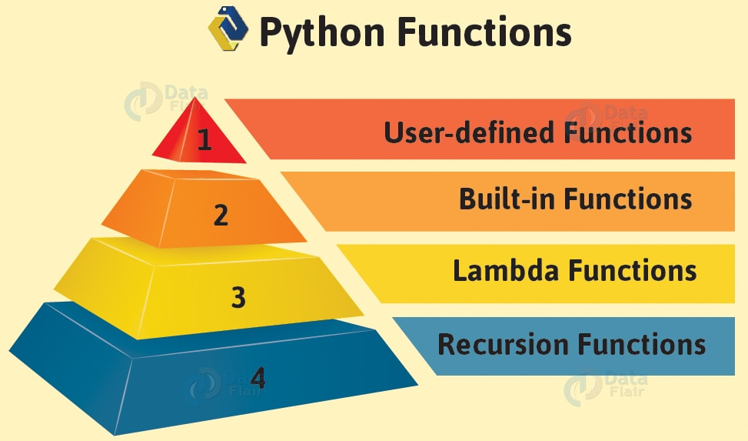

Slide 5
Advantages of User-defined Functions in Python
This Python Function help divide a program into modules. This makes the code easier to manage, debug, and scale.
It implements code reuse. Every time you need to execute a sequence of statements, all you need to do is to call the function.
This Python Function allow us to change functionality easily, and different programmers can work on different functions.

Slide 6
Rules for naming python function (identifier)
We follow the same rules when naming a function as we do when naming a variable.
It can begin with either of the following: A-Z, a-z, and underscore(_).
The rest of it can contain either of the following: A-Z, a-z, digits(0-9), and underscore(_).
A reserved keyword may not be chosen as an identifier
It is good practice to name a Python function according to what it does.

Slide 7
Defining a function
Syntax of Function
def function_name(parameters):
"""docstring"""
statement(s)
Above shown is a function definition that consists of the following components.
Keyword def that marks the start of the function header.
A function name to uniquely identify the function. Function naming follows the same rules of writing identifiers in Python.
Parameters (arguments) through which we pass values to a function. They are optional.
A colon (:) to mark the end of the function header.
Optional documentation string (docstring) to describe what the function does.
One or more valid python statements that make up the function body. Statements must have the same indentation level (usually 4 spaces).
An optional return statement to return a value from the function.

Slide 8
Python __doc__ attribute
Whenever string literals are present just after the definition of a function, module, class or method, they are associated with the object as their __doc__ attribute. We can later use this attribute to retrieve this docstring.

Slide 9
Defining a function (Cont.)
Example of a function
Function without any arguments
def my_function():
print("Hello From My Function!")
Functions may also receive arguments (variables passed from the caller to the function).
def my_function_with_args(username, greeting):
print("Hello",username , "From My Function!, I wish you", greeting)
Functions may return a value to the caller, using the keyword- 'return'.
def sum_two_numbers(a, b):
return a + b

Slide 10
Defining a function (Cont.)
Example of a function
def greet(name):
"""
This function greets to the person
passed in as a parameter
"""
print("Hello, " + name + ". Good morning!")

Slide 11
Defining a function (Cont.)
The pass Statement
The function definitions cannot be empty, but if you for some reason have a function definition with no content, put in the pass statement to avoid getting an error.
Example
def myfunction(): pass

Slide 12
Calling a function
Once we have defined a function, we can call it from another function, program or even the Python prompt.
To call a function we simply type the function name with appropriate parameters.
def my_function(): print("Hello from a function") my_function()

Slide 13
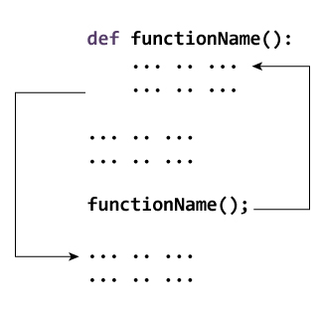
Calling a function
Working of function

Slide 14
Function Arguments
Information can be passed into functions as arguments.
Arguments are specified after the function name, inside the parentheses. You can add as many arguments as you want, just separate them with a comma.
The following example has a function with one argument (fname). When the function is called, we pass along a first name, which is used inside the function to print the full name:
def my_function(fname): print(“Hi”,fname) my_function(“Tanvi") my_function(“Dhara") my_function(“Kinjal")

Slide 15
Function Arguments (Cont.)
Parameters or Arguments?
The terms parameter and argument can be used for the same thing: information that are passed into a function.
From a function's perspective:
A parameter is the variable listed inside the parentheses in the function definition.
An argument is the value that is sent to the function when it is called.

Slide 16
Function Arguments (Cont.)
Number of Arguments
By default, a function must be called with the correct number of arguments. Meaning that if your function expects 2 arguments, you have to call the function with 2 arguments, not more, and not less.
Example
This function expects 2 arguments, and gets 2 arguments:
def my_function(fname, lname): print(fname + " " + lname) my_function(“Tanvi", “Patel")

Slide 17
Function Arguments (Cont.)
Variable Function Arguments
Up until now, functions had a fixed number of arguments. In Python, there are other ways to define a function that can take variable number of arguments.
Three different forms of this type are described below.
Python Default Arguments: Function arguments can have default values in Python.
Python Keyword Arguments: When we call functions in this way, the order (position) of the arguments can be changed.
Python Arbitrary Arguments: Sometimes, we do not know in advance the number of arguments that will be passed into a function. Python allows us to handle this kind of situation through function calls with an arbitrary number of arguments.

Slide 18
Function Arguments (Cont.)
Default Arguments
The following example shows how to use a default parameter value.
If we call the function without argument, it uses the default value.
We can provide a default value to an argument by using the assignment operator (=).
Example
def my_function(country = “India,china“): print("I am from " + country) my_function("Sweden") my_function(“Canda") my_function() my_function("Brazil")

Slide 19
Function Arguments (Cont.)
Keyword Arguments
You can also send arguments with the key = value syntax.
This way the order of the arguments does not matter.
Example
def my_function(child3, child2, child1): print("The youngest child is " + child3) my_function(child1 = “kid1", child2 = “kid2", child3 = “kid3")

Slide 20
Function Arguments (Cont.)
Arbitrary Arguments, *args
If you do not know how many arguments that will be passed into your function, add a * before the parameter name in the function definition.
This way the function will receive a tuple of arguments, and can access the items accordingly.
If the number of arguments is unknown, add a * before the parameter name:
def my_function(*kids): print("The youngest child is " + kids[2]) my_function(“kid1", “kid2", “kid3")

Slide 21
Function Arguments (Cont.)
Arbitrary Keyword Arguments, **kwargs
If you do not know how many keyword arguments that will be passed into your function, add two asterisk: ** before the parameter name in the function definition.
This way the function will receive a dictionary of arguments, and can access the items accordingly.
Example
If the number of keyword arguments is unknown, add a double ** before the parameter name:
def my_function(**kid): print("His last name is " + kid["lname"]) my_function(fname = “Naavya", lname = “Patel")

Slide 22
Function Arguments (Cont.)
Passing a List as an Argument
You can send any data types of argument to a function (string, number, list, dictionary etc.), and it will be treated as the same data type inside the function.
E.g. if you send a List as an argument, it will still be a List when it reaches the function.
def my_function(food): for x in food: print(x) fruits = ["apple", "banana", "cherry"] my_function(fruits)

Slide 23
Calling a function (Cont.)
Pass by reference and pass by value
One important thing to note is, in Python every variable name is a reference. When we pass a variable to a function, a new reference to the object is created.
Here x is a new reference to same list “lst”
def myFun(x):
x[0] = 20
After function call.
lst = [10, 11, 12, 13, 14, 15]
myFun(lst)
print(lst)

Slide 24
Calling a function (Cont.)
When we pass a reference and change the received reference to something else, the connection between passed and received parameter is broken.
Example
def myFun(x):
x = [20, 30, 40]
lst = [10, 11, 12, 13, 14, 15]
myFun(lst)
print(lst)

Slide 25
Pass by reference vs value
Pass means to provide an argument to a function.
The terms “pass by value” and “pass by reference” are used to describe how variables are passed on.
To make it short: pass by value means the actual value is passed on.
Pass by reference means a number (called an address) is passed on which defines where the value is stored

Slide 27
Pass by value
Passing by value means that the value of the function parameter is copied into another location of your memory, and when accessing or modifying the variable within your function, only the copy is accessed/modified and the original value is left untouched.
Passing by value is how your values are passed on most of the time.
For example: (java)
function add(int a, int b)

Slide 28
Pass by reference
Passing by reference means that the memory address of the variable (a pointer to the memory location) is passed to the function
means that the argument you’re passing to the function is a reference to a variable that already exists in memory rather than an independent copy of that variable.
For example: (java example)
function add(int &a, int &b)

Slide 29
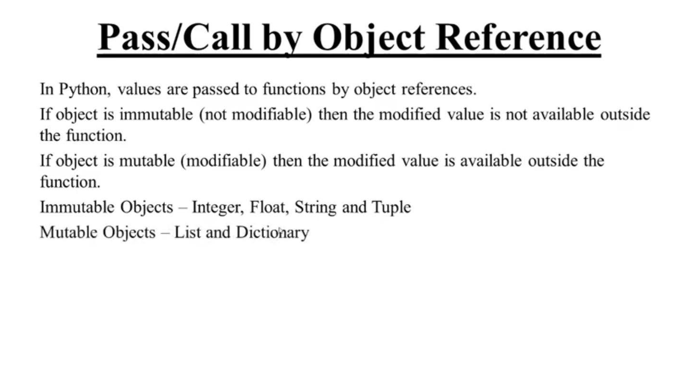

Slide 30
Pass by object reference
Immutable: objects whose value cannot change
1 Tuples
2 Booleans
3 Numbers
4 Strings
Mutable: objects whose value can change
1 Dictionaries
2 Lists
3 Set
This distinction matters because it explains seemingly contradictory behaviour

Slide 31
Pass by object reference
#variables are really names
c = 4
d = c
c+=1
print( c)
print(d) #d does not change because numbers are immutable
#lists are mutable
a = [1,4,2]
b = a #so this assigns the name b to the object attached to name a
a.append(3)
print( a)
print( b) #b still points to the same object, its contents have just changed.

Slide 32
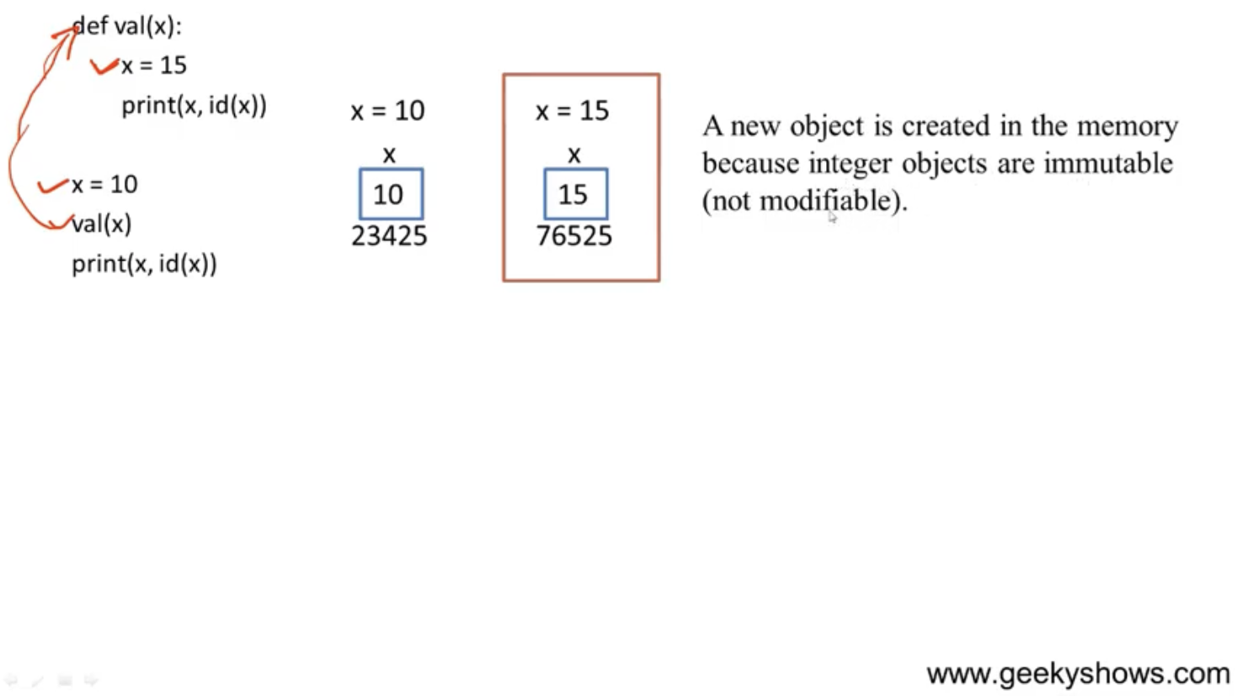

Slide 33
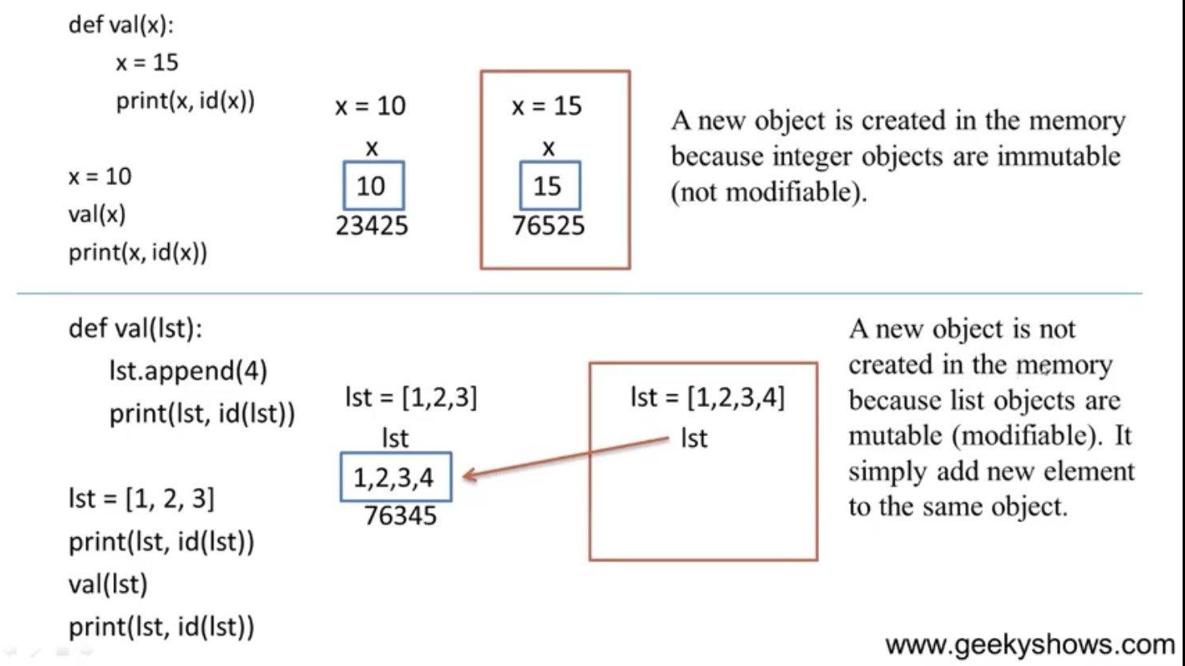
eg:

Slide 34
Calling a function (Cont.)
Return Statement
The return statement is used to exit a function and go back to the place from where it was called.
Syntax of return
return [expression_list]
This statement can contain an expression that gets evaluated and the value is returned. If there is no expression in the statement or the return statement itself is not present inside a function, then the function will return the None object.
Example
def my_function(x): return 5 * x print(my_function(3)) print(my_function(5)) print(my_function(9))

Slide 35
Calling a function (Cont.)
Example of return
def absolute_value(num):
"""This function returns the absolute
value of the entered number"""
if num >= 0:
return num
else:
return -num
print(absolute_value(2))
print(absolute_value(-4))

Slide 36
Types of functions
There are three types of functions in Python:
Built-in functions, such as help() to ask for help, min() to get the minimum value, print() to print an object to the terminal, and many more.
User-Defined Functions (UDFs), which are functions that users create to help them out.
Anonymous functions, which are also called lambda functions because they are not declared with the standard def keyword.

Slide 37
Anonymous Function / Lambda Function
In Python, an anonymous function is a function that is defined without a name.
While normal functions are defined using the def keyword in Python, anonymous functions are defined using the lambda keyword.
Hence, anonymous functions are also called lambda functions.
A lambda function in python has the following syntax.
Syntax of Lambda Function in python
lambda arguments: expression
Lambda functions can have any number of arguments but only one expression. The expression is evaluated and returned. Lambda functions can be used wherever function objects are required.
An anonymous function cannot be a direct call to print because lambda requires an expression

Slide 38
Anonymous Function / Lambda Function (Cont.)
Example
double = lambda x: x * 2
print(double(5)) 🡺 10
In the above program, lambda x: x * 2 is the lambda function. Here x is the argument and x * 2 is the expression that gets evaluated and returned.
This function has no name. It returns a function object which is assigned to the identifier double.
It is nearly the same as below function.
def double(x):
return x * 2

Slide 39
Anonymous Function / Lambda Function (Cont.)
Use of Lambda Function in python
We use lambda functions when we require a nameless function for a short period of time.
In Python, we generally use it as an argument to a higher-order function (a function that takes in other functions as arguments).
Lambda functions are used along with built-in functions like filter(), map() etc.

Slide 40
Anonymous Function / Lambda Function (Cont.)
Example use with filter()
The filter() function returns an iterator were the items are filtered through a function to test if the item is accepted or not.
filter(function, iterable)
The filter() function in Python takes in a function and a list as arguments.
The function is called with all the items in the list and a new list is returned which contains items for which the function evaluates to True.
Here is an example use of filter() function to filter out only even numbers from a list.

Slide 41
Program to filter out only the even items from a list
my_list = [1, 5, 4, 6, 8, 11, 3, 12]
new_list = list(filter(lambda x: (x%2 == 0) , my_list))
print(new_list) 🡺 [4, 6, 8, 12]

Slide 42
Anonymous Function / Lambda Function (Cont.)
Example use with map()
The map() function executes a specified function for each item in an iterable. The item is sent to the function as a parameter.
map(function, iterables)
The map() function in Python takes in a function and a list.
The function is called with all the items in the list and a new list is returned which contains items returned by that function for each item.
Here is an example use of map() function to double all the items in a list.

Slide 43
Program to double each item in a list using map()
my_list = [1, 5, 4, 6, 8, 11, 3, 12]
new_list = list(map(lambda x: x * 2 , my_list))
print(new_list) 🡺 [2, 10, 8, 12, 16, 22, 6, 24]

Slide 44
Anonymous Function / Lambda Function (Cont.)
Example
sum = lambda arg1, arg2: arg1 + arg2
Now you can call sum as a function
print ("Value of total : ", sum( 10, 20 ))
print ("Value of total : ", sum( 20, 20 ))

Slide 45
Scope and Lifetime of variables
Scope of a variable is the portion of a program where the variable is recognized. Parameters and variables defined inside a function are not visible from outside the function. Hence, they have a local scope.
The lifetime of a variable is the period throughout which the variable exits in the memory. The lifetime of variables inside a function is as long as the function executes.
They are destroyed once we return from the function. Hence, a function does not remember the value of a variable from its previous calls.
def my_func():
x = 10
print("Value inside function:",x)
x = 20
my_func()
print("Value outside function:",x)

Slide 46
Local and Global variables
Local Variables
A variable declared inside the function's body or in the local scope is known as a local variable.
Example: Accessing local variable outside the scope
def foo():
y = "local"
foo()
print(y)
Output: NameError: name 'y' is not defined

Slide 47
Local and Global variables (Cont.)
Normally, we declare a variable inside the function to create a local variable.
def foo():
y = "local"
print(y)
foo()
Output: local

Slide 48
Local and Global variables (Cont.)
Global Variables
In Python, a variable declared outside of the function or in global scope is known as a global variable. This means that a global variable can be accessed inside or outside of the function.
Example: Create a Global Variable
x = "global"
def foo():
print("x inside:", x)
foo()
print("x outside:", x)
Output:
x inside: global
x outside: global

Slide 49
Local and Global variables (Cont.)
What if you want to change the value of x inside a function?
x = "global"
def foo():
x = x * 2
print(x)
foo()
Output
UnboundLocalError: local variable 'x' referenced before assignment
The output shows an error because Python treats x as a local variable and x is also not defined inside foo().
To make this work, we use the global keyword.

Slide 50
Local and Global variables (Cont.)
Global Keyword
In Python, global keyword allows you to modify the variable outside of the current scope. It is used to create a global variable and make changes to the variable in a local context.
Rules of global Keyword
The basic rules for global keyword in Python are:
When we create a variable inside a function, it is local by default.
When we define a variable outside of a function, it is global by default. You don't have to use global keyword.
We use global keyword to read and write a global variable inside a function.
Use of global keyword outside a function has no effect.

Slide 51
Local and Global variables (Cont.)
Example: Accessing global Variable From Inside a Function
c = 1 # global variable
def add():
print(c)
add()
Output: 1
Example: Modifying Global Variable From Inside the Function
c = 1 # global variable
def add():
c = c + 2
print(c)
add()
Output: UnboundLocalError: local variable 'c' referenced before assignment

Slide 52
Local and Global variables (Cont.)
Example: Changing Global Variable From Inside a Function using global
c = 0 # global variable
def add():
global c
c = c + 2
print("Inside add():", c)
add()
print("In main:", c)
Output:
Inside add(): 2
In main: 2

Slide 53
Local and Global variables (Cont.)
Example: Using Global and Local variables in the same code
x = "global"
def foo():
global x
y = "local"
x = x * 2
print(x)
print(y)
foo()
Output
global global
local

Slide 54
Local and Global variables (Cont.)
Example: Global variable and Local variable with same name
x = 5
def foo():
x = 10
print("local x:", x)
foo()
print("global x:", x)
Output
local x: 10
global x: 5

Slide 55
What is recursion?
Recursion is the process of defining something in terms of itself.
A physical world example would be to place two parallel mirrors facing each other. Any object in between them would be reflected recursively.
In programming, The process in which a function calls itself directly or indirectly is called recursion and the corresponding function is called as recursive function.
Recursion is a common mathematical and programming concept. It means that a function calls itself. This has the benefit of meaning that you can loop through data to reach a result.

Slide 56
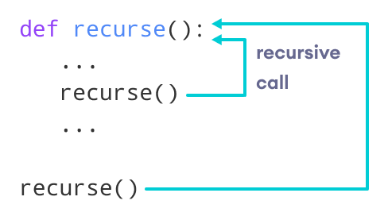
Python Recursive Function
In Python, we know that a function can call other functions. It is even possible for the function to call itself. These types of construct are termed as recursive functions.
The following image shows the working of a recursive function called recurse.

Slide 57
Python Recursive Function
Breaking a problem down into a series of steps.
The final step is reached when some basic condition is satisfied.
The solution for each step is used to solve the previous step.
The solution for all the steps together form the solution to the whole problem.

Slide 58
Terminology
def f(n):
if n == 1:
return 1
else:
return f(n - 1)
"Useful" recursive functions have:
at least one recursive case
at least one base case so that the computation terminates
base
case
recursive
case

Slide 59
Example 1: recursion
Consider the mathematical definition of b^{n}, where n is a non-negative integer:
b^{n} = 1 if n = 0 b^{n} = b ₓ b^{n–1} if n > 0
This definition is recursive, and immediately suggests a recursive function:
def power (b, n): if n == 0: return 1 else: return b * power(b, n-1)

Slide 60
Example 2: factorial of number
The factorial of a number is the product of all the integers from 1 to that number. For example, the factorial of 6 is 1*2*3*4*5*6 = 720 . Factorial is not defined for negative numbers, and the factorial of zero is one, 0
factorial(3) # 1st call with 3
3 * factorial(2) # 2nd call with 2
3 * 2 * factorial(1) # 3rd call with 1
3 * 2 * 1 # return from 3rd call as number=1
3 * 2 # return from 2nd call
6 # return from 1st call

Slide 61
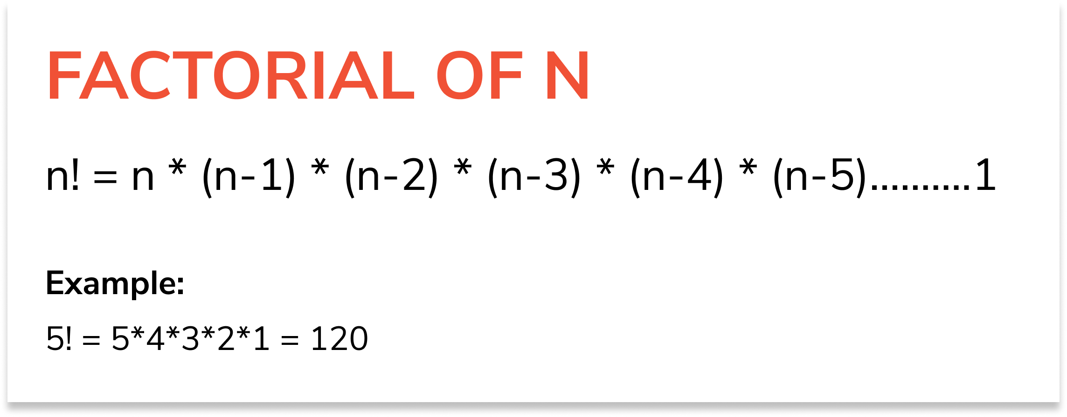
Factorial example

Slide 62
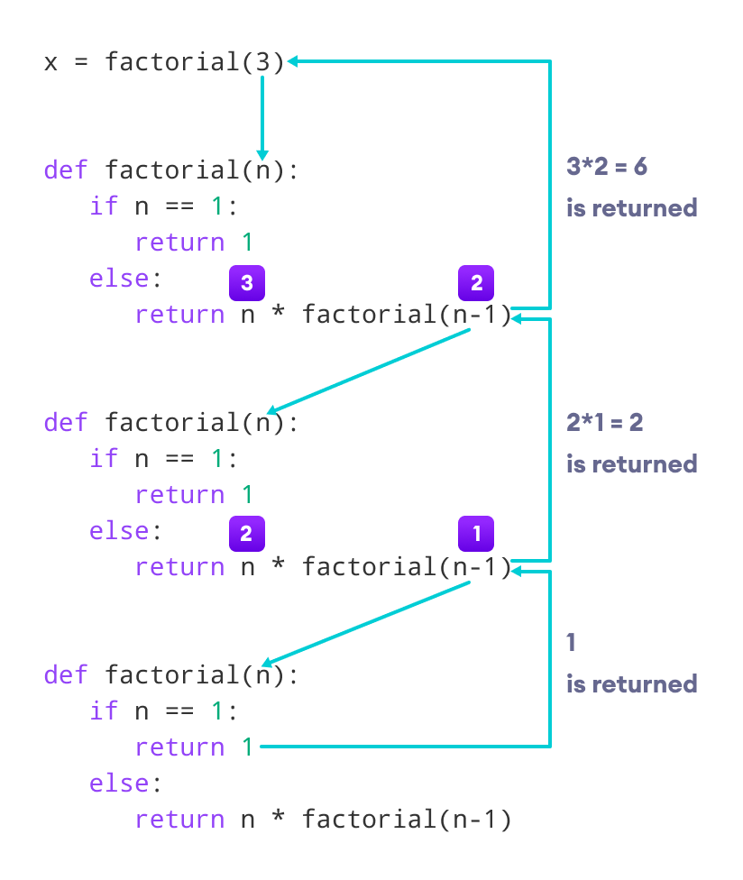

Slide 63
Python Recursive Function
Our recursion ends when the number reduces to 1. This is called the base condition.
Every recursive function must have a base condition that stops the recursion or else the function calls itself infinitely.
The Python interpreter limits the depths of recursion to help avoid infinite recursions, resulting in stack overflows.
By default, the maximum depth of recursion is 1000. If the limit is crossed, it results in Recursion Error. Let's look at one such condition.

Slide 64
Advantages of Recursion
Recursive functions make the code look clean and elegant.
A complex task can be broken down into simpler sub-problems using recursion.
Sequence generation is easier with recursion than using some nested iteration.

Slide 65
Disadvantages of Recursion
Sometimes the logic behind recursion is hard to follow through.
Recursive calls are expensive (inefficient) as they take up a lot of memory and time.
Recursive functions are hard to debug.

Slide 66
Thank You

